Slide 1
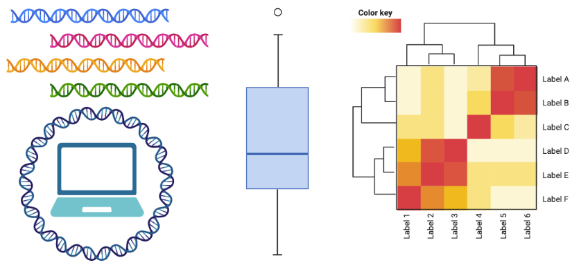
FDST 867 Lab Fall 2022
GitHub page: https://github.com/azureycy/FDST867_lab_fall_2022
Yanbin Yin, Yuchen Yan
10/26/2022

Slide 2
what you need to know
use holland computing cluster so bring a laptop and have an HCC account
hands-on activities with a real-world genome mining project
focus on data visualization during demonstration
some data computing takes long time, but all intermediate codes are provided
use HCC OnDemand R studio + Shell terminal

Slide 3
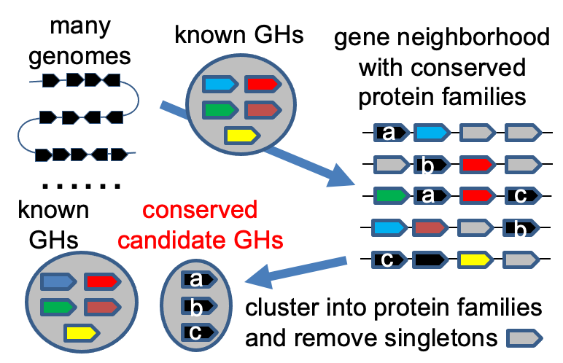
about the project
a new project from a recent proposal
it will or should work
input -> genomes,
output -> new GH predictions
our focus is data analysis and visualization

Slide 4
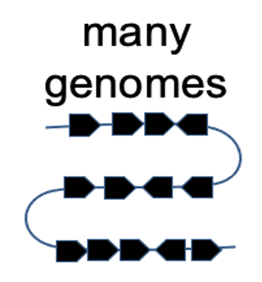
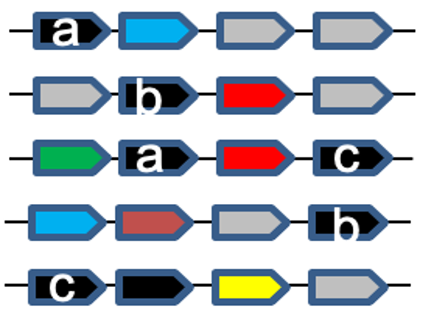
steps
input -> 44 Bacteroides genomes from human gut
find CAZymes and CGCs (CAZyme gene clusters)

Slide 5
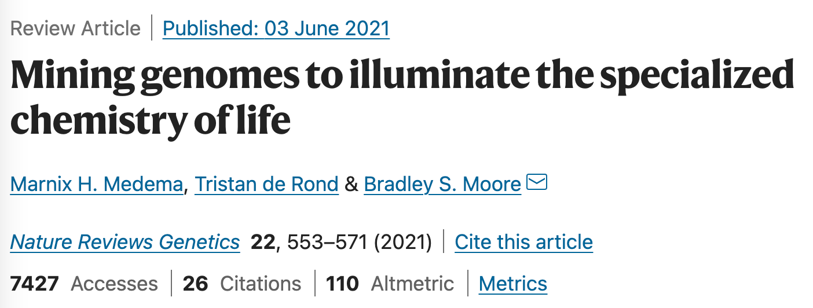
(meta)genome mining
Targeted search of genomes for specific pathways or genes with important economic values using advanced computational data mining approaches

Slide 6
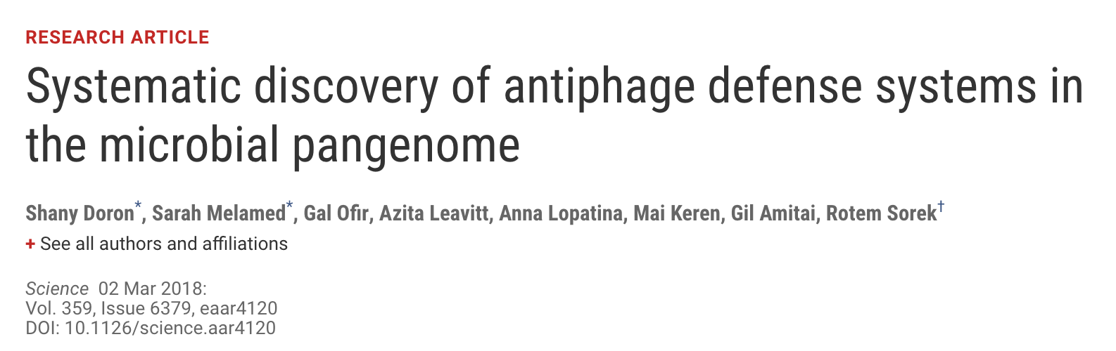
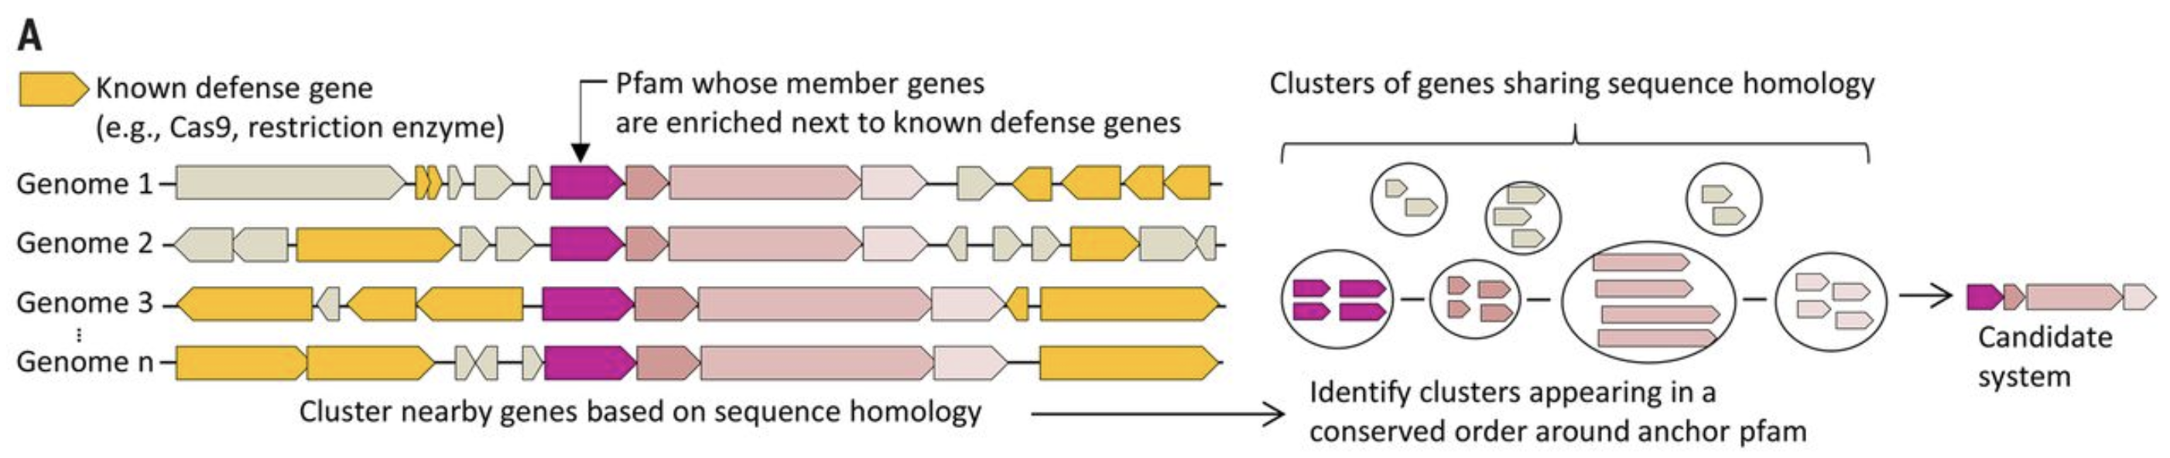
Defense island: gene clusters that encode antiphage defense genes

Slide 7
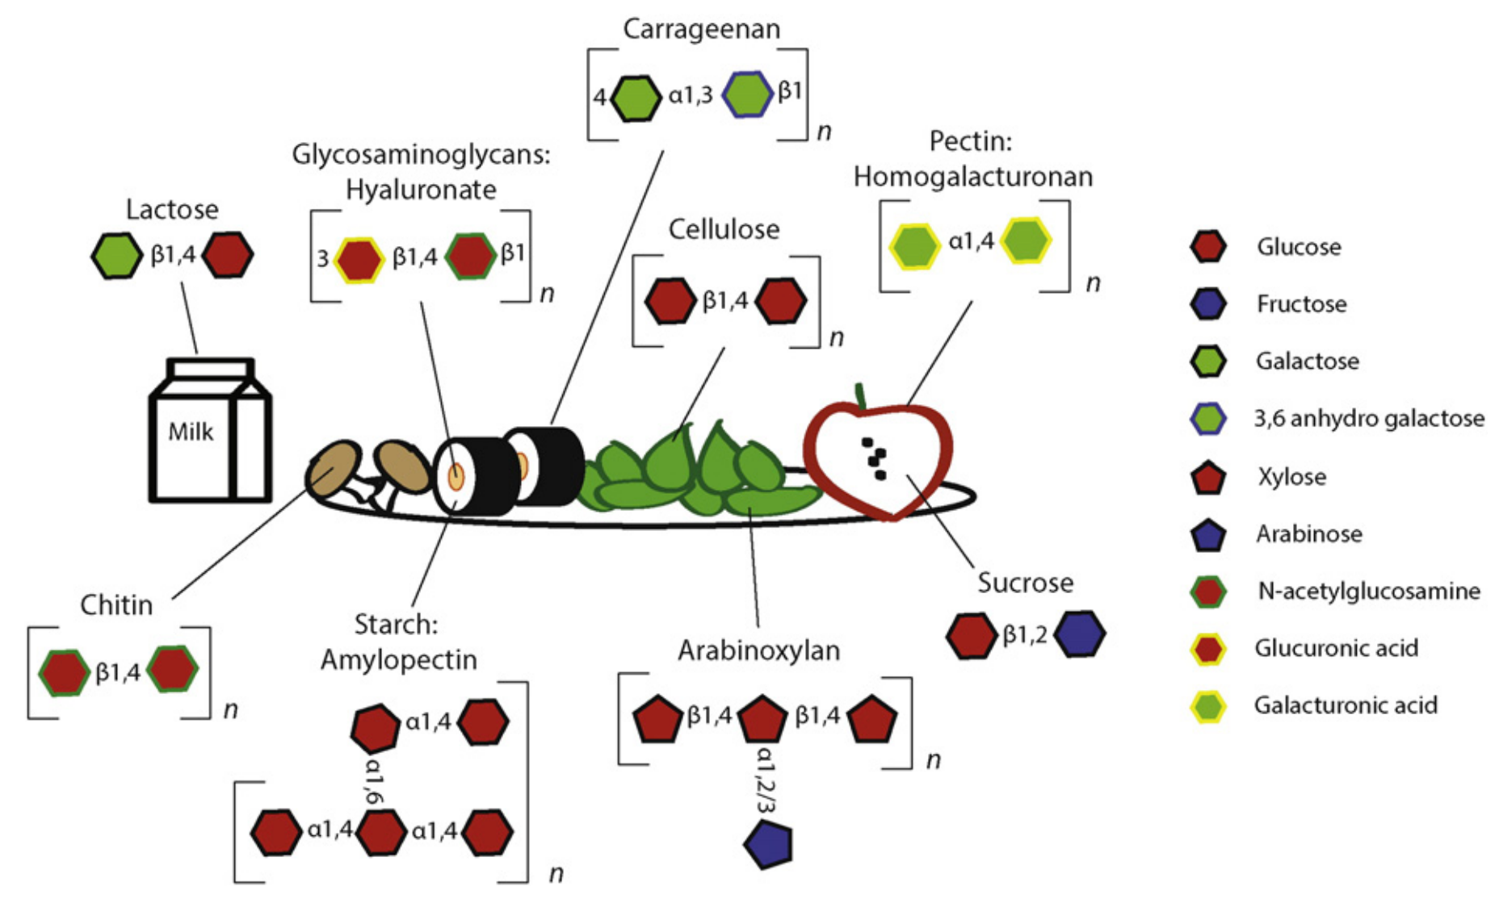
a high diversity of dietary carbohydrates
J Mol Biol (2016) 428, 3230–3252
Notes:
if you think about what your eat everyday, there are a high diversity of dietary carbohydrates in our foods from milk to vegie to fruit and meat. These carbohydrates exist as various polysaccharides, and glycoproteins, containing a high diversity of monosaccharides and of their linkages that connect them into glycan polysacccharides.

Slide 8
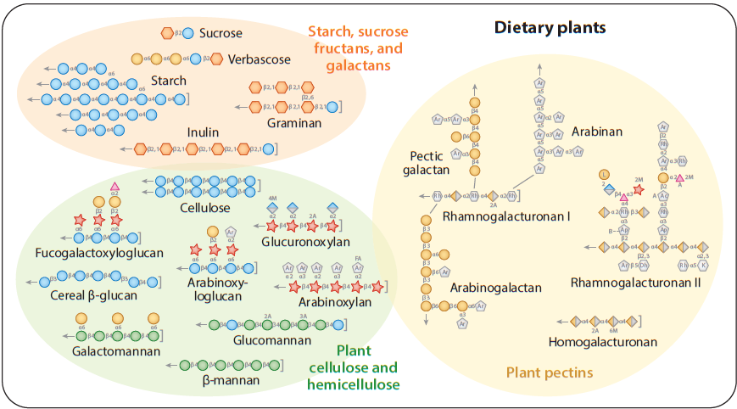

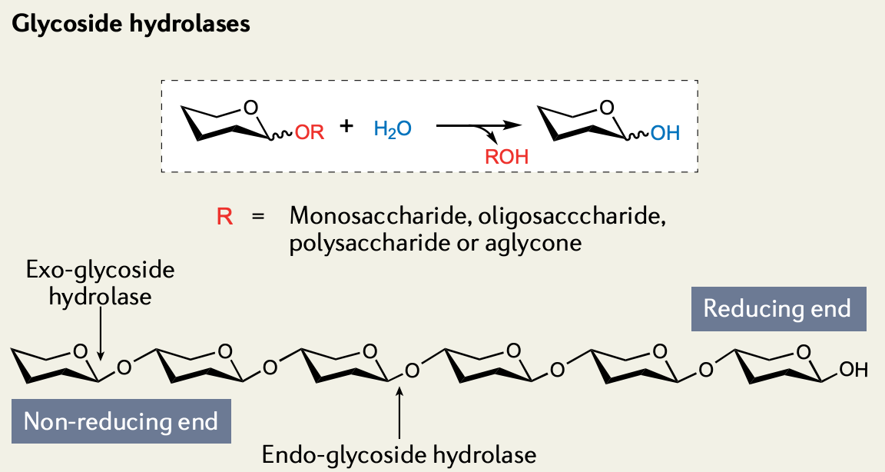
diverse glycosidic linkages exist in the dietary carbs
Annu. Rev. Microbiol (2017) 71:349–69
Notes:
These sugar connecting linkages are called glycosidic bonds. Breaking these bonds need carbohydrate active enzymes or CAZymes. Each of these different glycosidic bond will need a different CAZyme. Therefore to fully break down complex carbs into simple sugars, a large number of CAZymes will be needed.

Slide 9
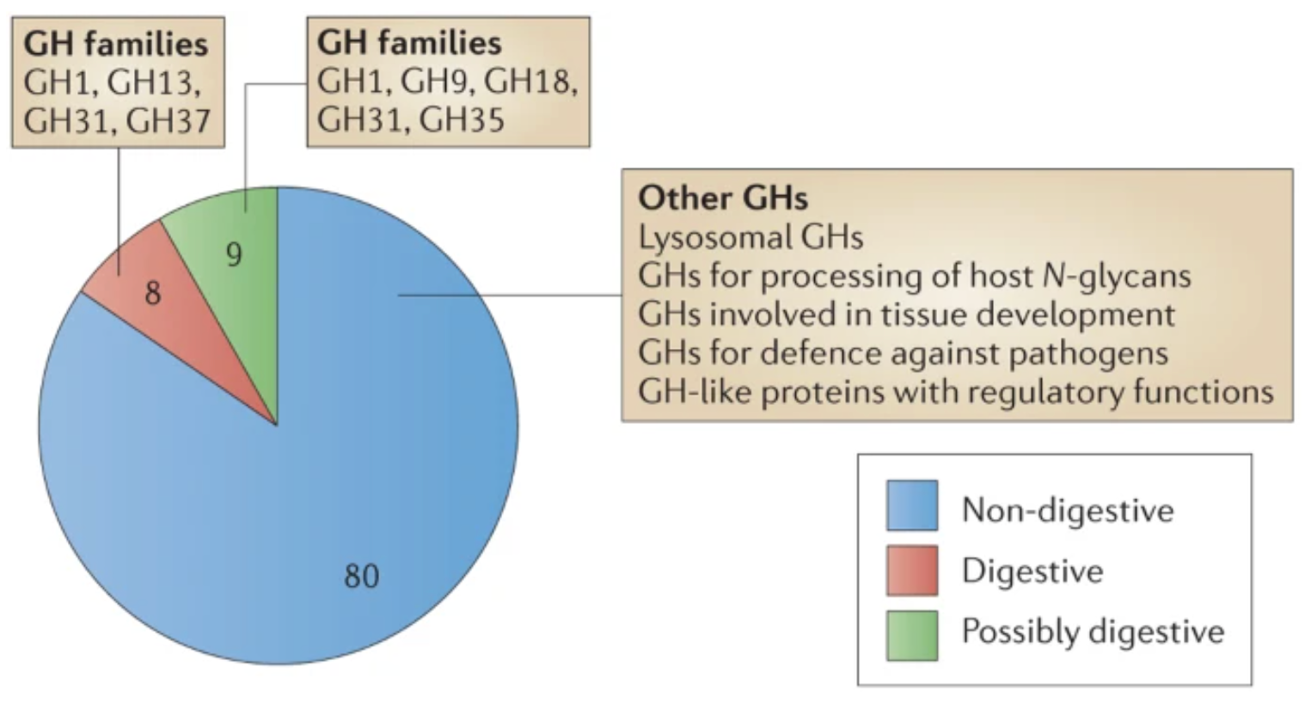
diverse glycosidic linkages need various CAZymes to break
http://www.cazy.org/
Human encodes 17 food digesting GHs
GlycosylTransferases (GTs): 115
Glycoside Hydrolases (GHs): 172
Polysaccharide Lyases (PLs): 42
Carbohydrate Esterases (CEs): 19
Auxiliary Activities (AAs): 17
Carbohydrate-Binding Modules (CBMs): 89
Cantarel B. et al. 2009, Nucleic Acids Res
Lombard V. et al. 2014, Nucleic Acids Res
NATURE REVIEWS | MICROBIOLOGY, doi:10.1038/nrmicro3050, Kaoutari, 2013
Notes:
The CAZy database collects all the experimentally characterized CAZymes. They regularly curate biochemical data and collect their protein homologs to form six classes with each class including between over a dozen and almost 200 families. If looking at the human genome, there are only 17 food digesting GH CAZymes. So most of dietary fibers can’t be digested by human enzymes in upper GI tract and will reach the large intestine for gut microbes to digest

Slide 10
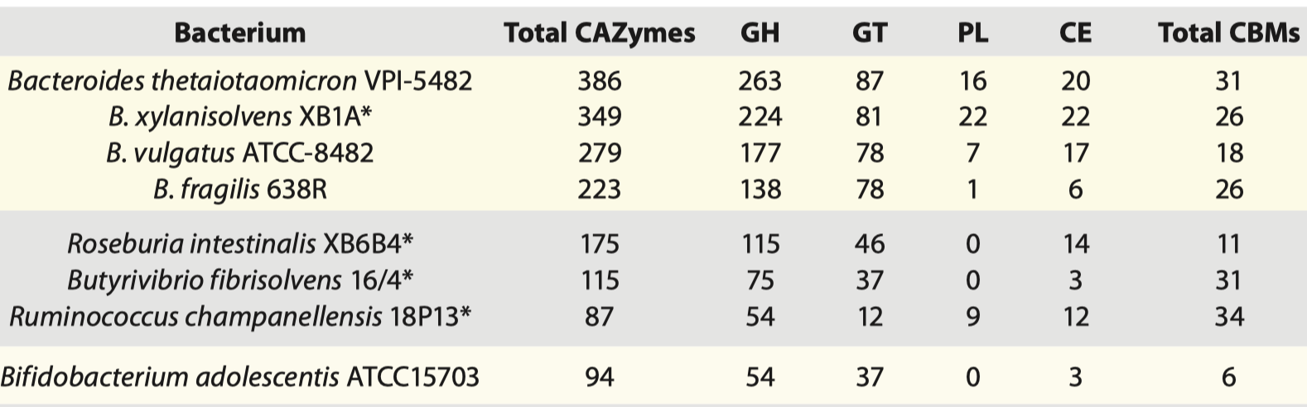
gut bacteria dedicate > 6% of their genes to CAZymes
Gut Microbes 3:4, 289-306; 2012
1000 (species) x 100 (genes) = 100,000 CAZymes
Notes:
That is why gut bacteria typically encode more than hundreds of CAZymes. Some bacteria can have over 6% of its genes encoding CAZymes. If there are 1000 bacterial species in human gut and each has 100 CAZyme genes, this means 100,000 CAZymes genes present in human gut microbiome, much larger than the number in human genome.

Slide 11


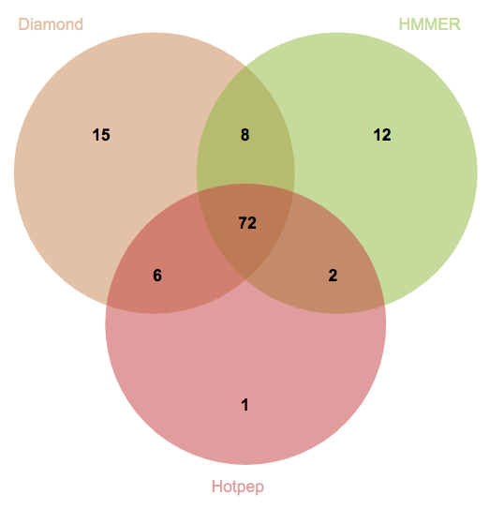
dbCAN2 combines three tools for CAZyme genome mining
BLAST vs. CAZy (before 2012)
Tanner
Family X
New genome
CAZymes
HMMER vs. dbCAN (after 2012)
Le
Family X
eCAMI (after 2017)
Family X
dbCAN: Yin et al, Nucleic acids research 2012
eCAMI: Xu J et al., Bioinformatics, 2020
Notes:
How do people annotate their microbial genomes and metagenomes for CAZymes? Before 2012, people BLAST their query against the CAZy protein sequence database. However, CAZymes are known to be modular and contain multiple domains. In 2012, we build a CAZyme HMM database called dbCAN, which defines a signature domain for each CAZyme family. This allows to identify all the CAZyme modules in a given query. After 2017, there are tools developed for short discrete amino acid peptides as the signature of each CAZyme family. One of these tools eCAMI was published by our lab in 2020. In 2018, we combined the three ideas and developed a meta server called dbCAN2, and we found CAZymes annotated by 2 and 3 tools are more accurate predictions.

Slide 12
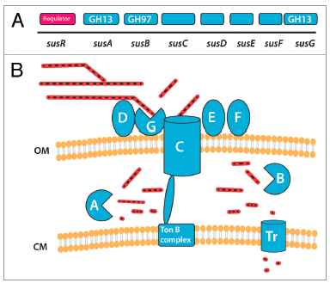
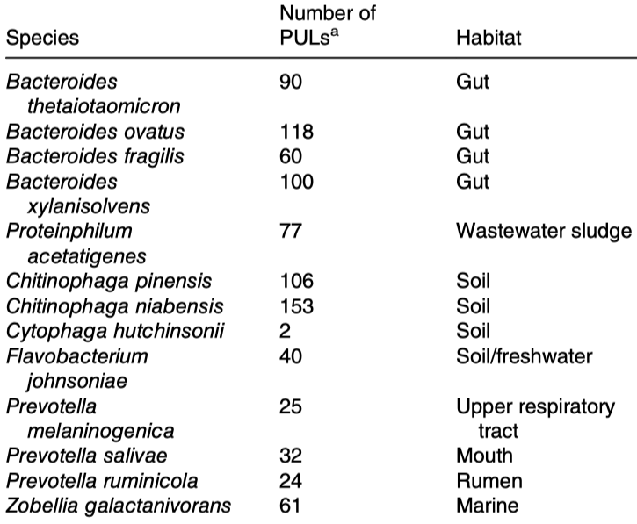
PUL: polysaccharide utilization loci
Sus in Bacteroides thetaiotaomicron
Gut Microbes 3:4, 289-306; 2012
Environmental Microbiology Reports (2021)
Notes:
One of major findings in carbohydrate utilization research is the discovery of polysaccharide utilization loci in late 1990’s. The first studied PUL is the starch utilization loci in Bacteroides theta, which contains three CAZymes, two transporters, one regulator, and others likely sugar binding proteins. Since 2005, hundreds of PULs have been described in the literature, while most of them are characterized in gram- bacteria. In 2016, PULs were also found in gram+ bacteria.

Slide 13
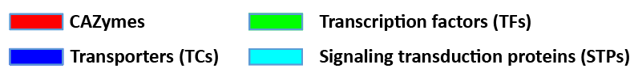
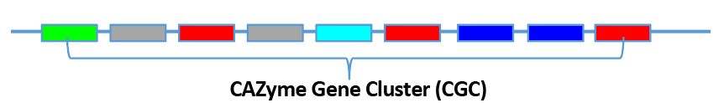
CGC-Finder: predict CAZyme gene clusters from (meta)genomes
Huang et al., Nucleic Acids Res 2018
Le
predict genes
predict signature genes
call CAZyme gene clusters
The distance threshold:
how many non-signature genes are inserted between two adjacent signature genes
Notes:
Obviously, CAZymes forming gene clusters is wide spread phenominon that microbes have evolved to adapt to carbohydrate rich environments like animal gut, forest floors, soils, oceans. Determining the substrates oof these gene clusters requires experimental characterization and can't be done in a high-throughput manner. However, predicting these gene clusters can be automated computationally. We have developed CGC-finder, a program to automatically scan any given DNA sequences to identify co-localized CAZymes, TCs, TFs, and STPs. It is integrated in the dbCAN tool package. Here is an example CGC that we identified from a RefSeq bacterial genome. It contains 42 genes and 35 are CAZymes.

Slide 14


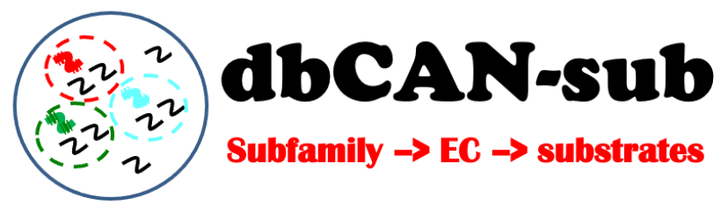


Summary
a very high diversity of carbs in our diet (other environment too)
dbCAN -> automated CAZyme genome mining
dbCAN-PUL -> literature derived PULs with known carb substrates
complex carb degrading genes form gene clusters in genomes
CGC-Finder can mine for these CGCs (without substrates)
https://bcb.unl.edu/dbCAN2
https://github.com/linnabrown/run_dbcan
https://bcb.unl.edu/dbCAN_PUL
https://github.com/yinlabniu/eCAMI
https://bcb.unl.edu/dbCAN_seq/
https://bcb.unl.edu/plantcazyme/
https://github.com/linnabrown/run_dbcan
https://bcb.unl.edu/dbCAN_PUL
https://github.com/yinlabniu/eCAMI
https://bcb.unl.edu/dbCAN_seq/
https://bcb.unl.edu/plantcazyme/
https://bcb.unl.edu/pHMM-Tree/source/
Notes:
Here is a list of web links to our dbCAN families tools.

Slide 15
Hands-on Session

Slide 16
Open your terminal and log in to HCC
Copy folder and open tutorial HTML
Step 1: Change directory from HOME to WORK: cd $WORK
Step 2: Click or copy this link to your web browser to open GitHub page:
https://github.com/azureycy/FDST867_lab_fall_2022
Click his

Slide 17
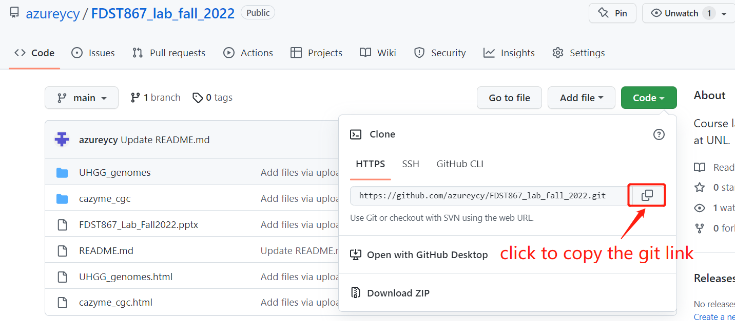
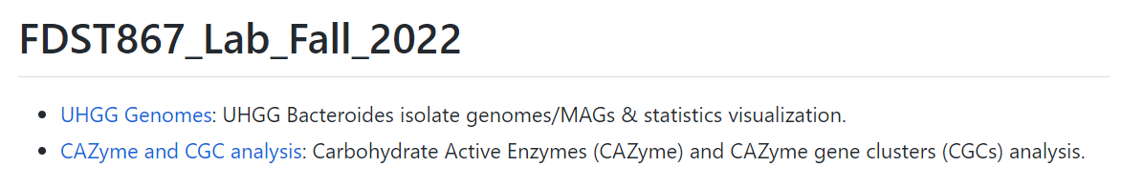
Step 3:
Paste to terminal:
git clone https://github.com/azureycy/FDST867_lab_fall_2022.git
Step 4: Open tutorial HTML file in GitHub page.
Click link

Slide 18
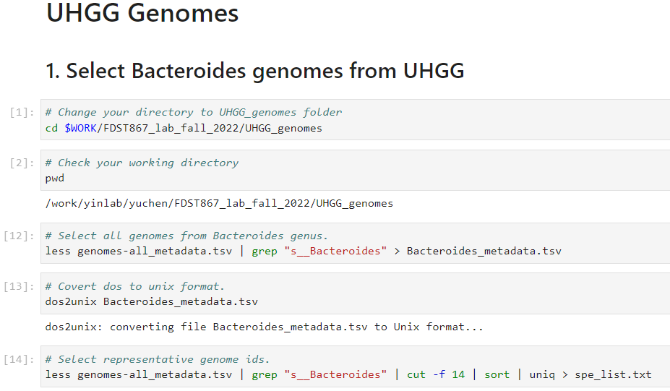
Step 5: Follow the tutorial HTML. Copy and paste each command line to your terminal and run it.

Slide 19

Part 1
UHGG Genomes
Tang Li

Slide 20
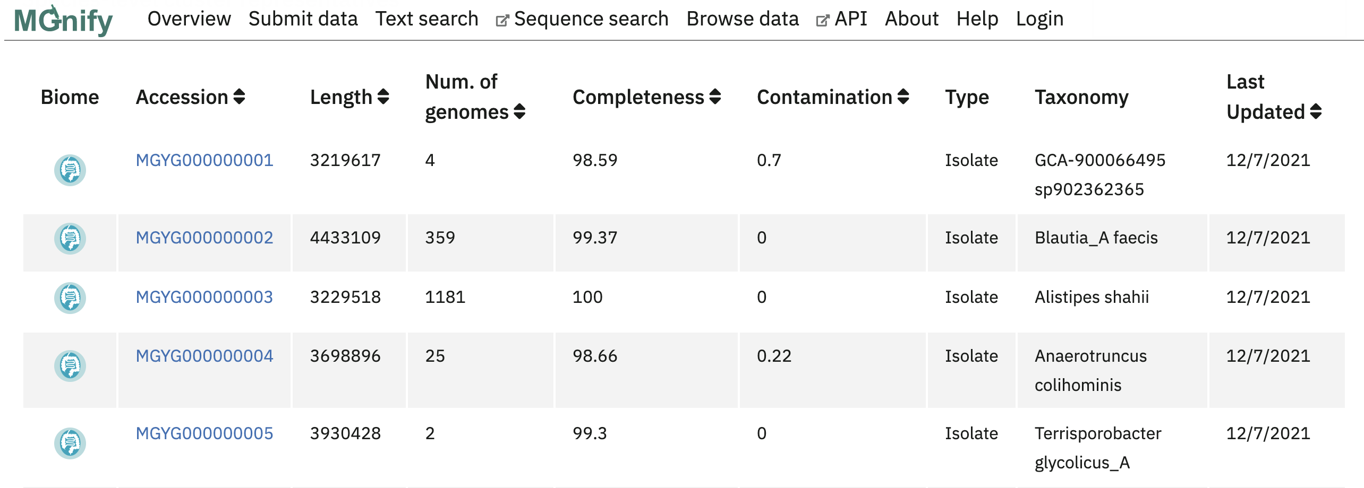
Unified Human Gastrointestinal Genome (UHGG)
A total of 289,232 prokaryotic genomes from the human gut microbiome were clustered into 4,744 species representatives.

Slide 21
Unified Human Gastrointestinal Genome (UHGG)
The “genomes-all_metadata.tsv” was downloaded from this web link: http://ftp.ebi.ac.uk/pub/databases/metagenomics/mgnify_genomes/human-gut/v2.0/genomes-all_metadata.tsv
Bacteroides: one of the most important genus in human gut microbiome; CAZyme and PULs are well-studied for this genus.

Slide 22
44 Bacteroides genomes from UHGG
Select representative species genomes in Bacteroides genus (n=44).
Download genomes.
Collect metadata information: genome id, species name, genome types, genome length, protein count, contig N50, completeness, country and continent.
Visualize metadata information for 44 genomes.

Slide 23

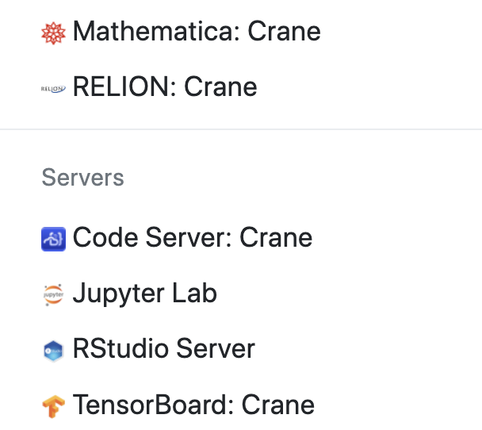
Use Crane OnDemand Rstudio server:
Click or copy the link to your browser: https://crane-ood.unl.edu/pun/sys/dashboard
Login using your HCC account.
Click “Interactive Apps” at the top bar..
Click “Rstudio Server” to start the Rstudio
3
4

Slide 24
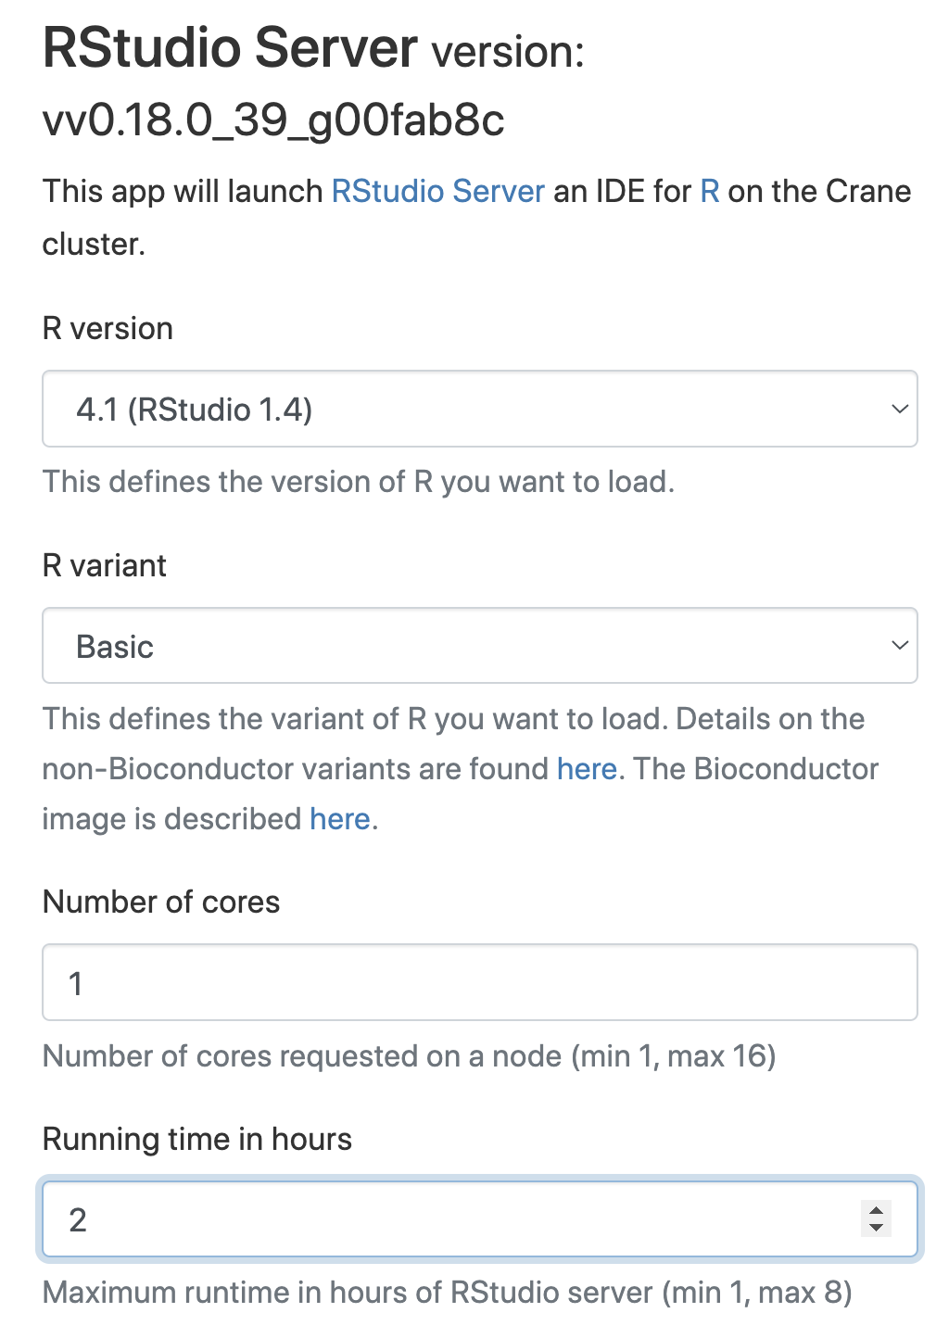

Use Crane OnDemand Rstudio server
5. Set running time to 1 or 2 hrs.
6. Click “Launch” at the bottom of the page.
4
6
5

Slide 25
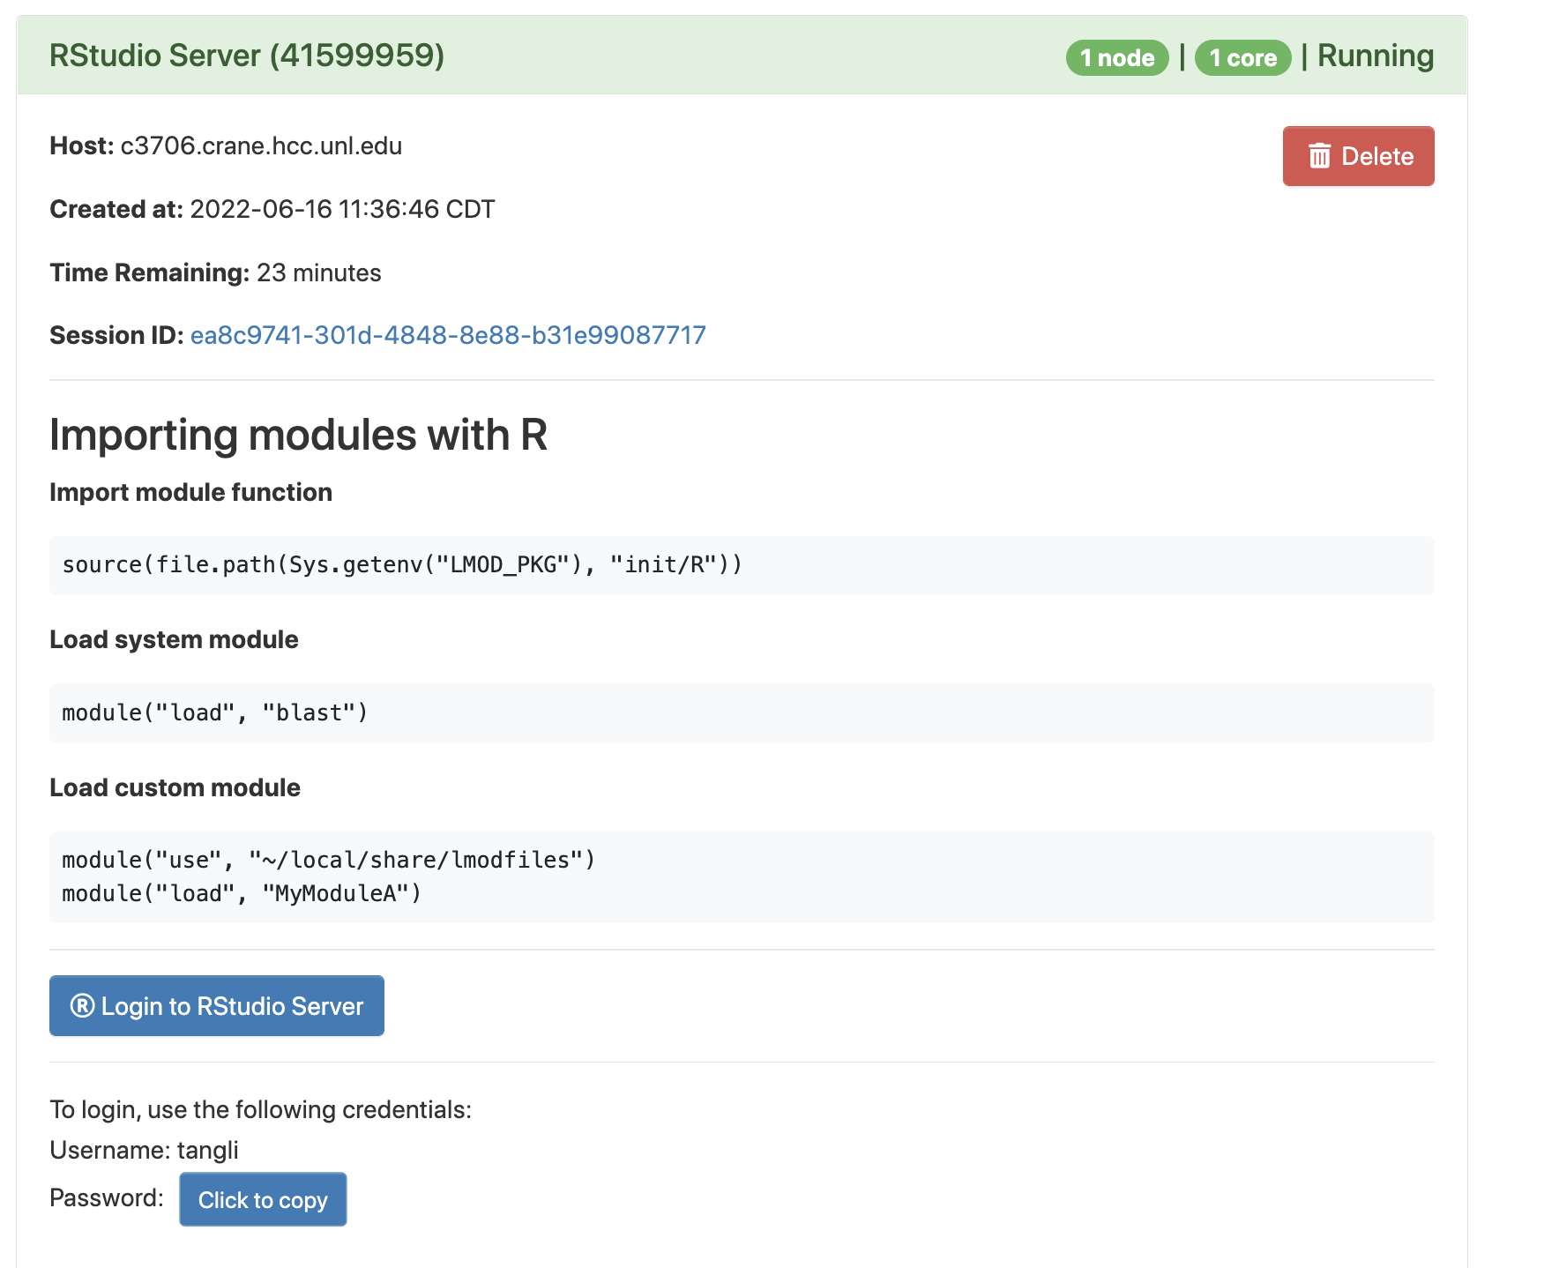
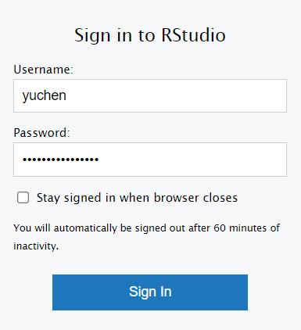
9
9. Login using username and copied password.
8
8. Click to login.
7
7. Click to copy the password.

Slide 26
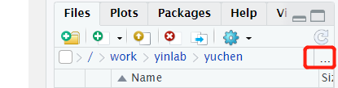
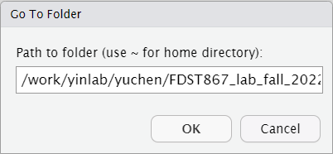
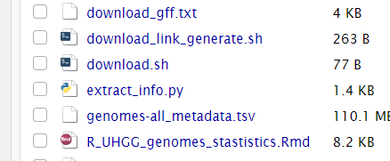
10.Click “…”to change the directory
10
11. Enter your working directory path: /work/your_group/your_name/FDST867_lab_fall_2022/UHGG_genomes
11
12. Open “R_UHGG_genomes_stastistics.Rmd”
12

Slide 27
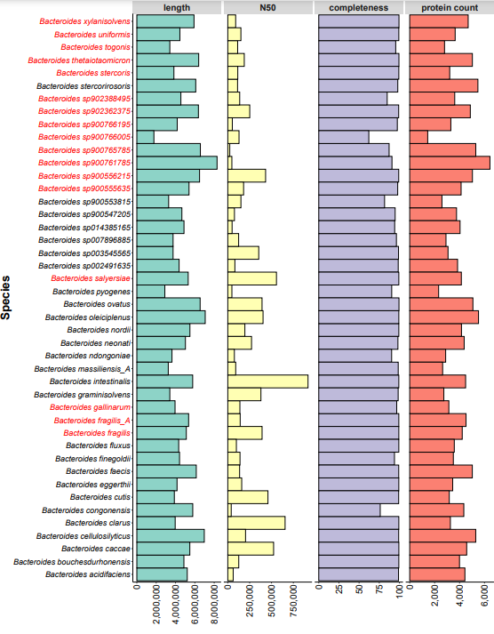
The Overall Statistics of 44 genomes
Genomes: 17 MAGs (red) and 27 isolates (back).
Average Length: ~4.87 Mb.
Completeness: 99.46% - 62.07% (only 5 genomes < 90%)
Protein count: 6,436 - 1,444.

Slide 28
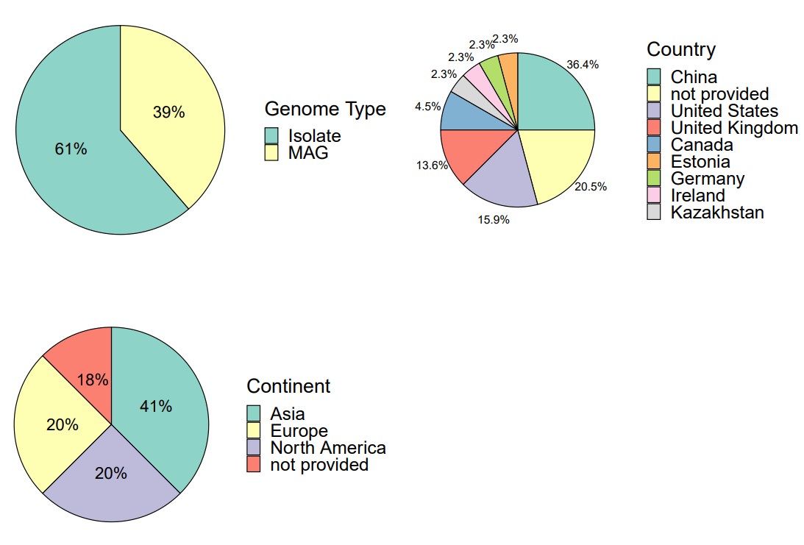
The Overall Statistics of 44 genomes
More isolate genomes than MAGs.
Most are from China, United States and United Kingdom.
Mainly from Asia.

Slide 29
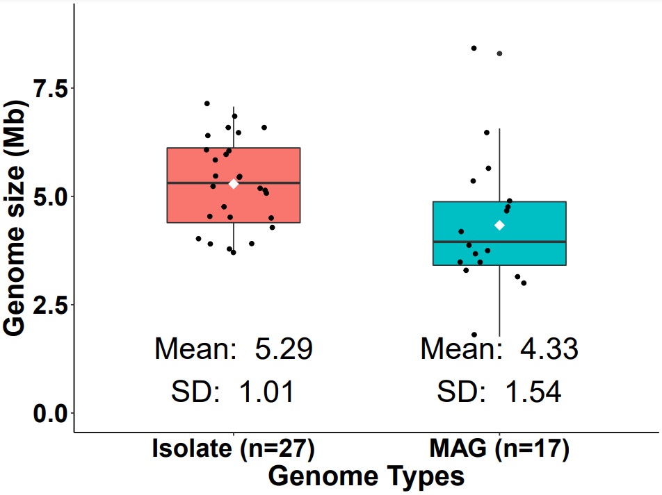
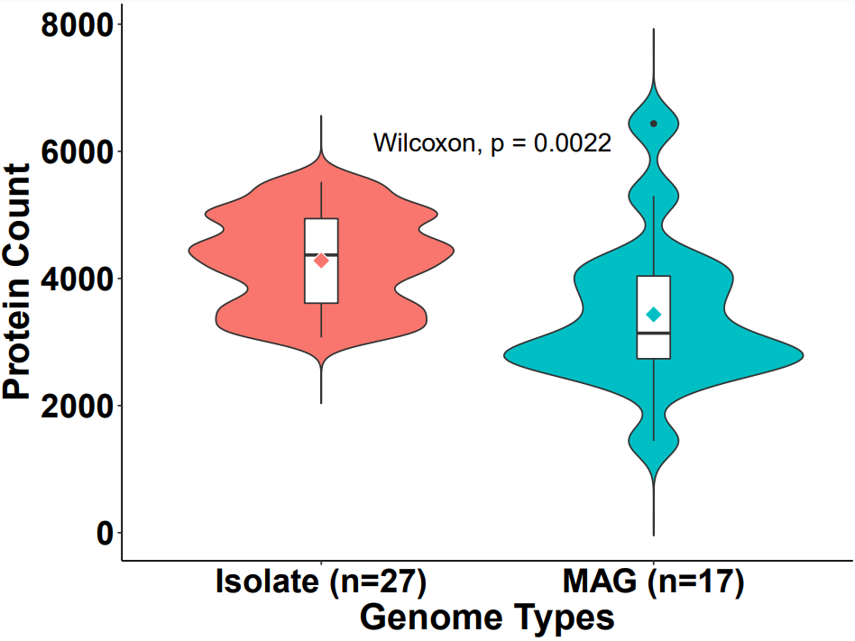
Group comparison for 44 genomes.
Isolate genomes have larger average genome size and more proteins than MAGs.

Slide 30
Part 2
CAZyme and CGC analyses

Slide 31
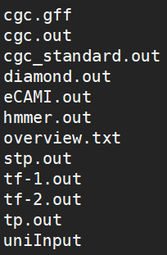
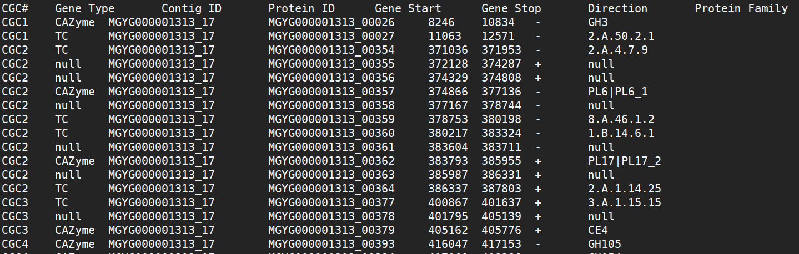
Run dbCAN2 for CAZyme and CGC annotation
Github: https://github.com/linnabrown/run_dbcan
Online server: https://bcb.unl.edu/dbCAN2/
(Install and run on terminal)
(submit sequence to online server)
dbCAN2 output files
cgc_standard.out

Slide 32
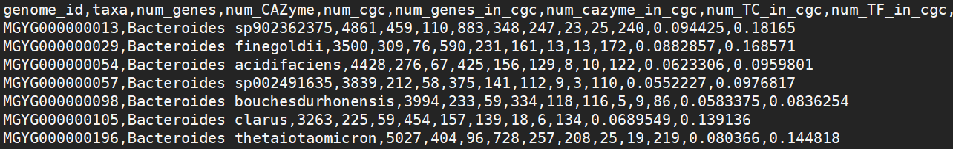
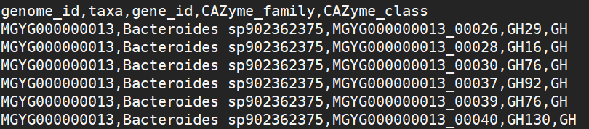
CAZyme and CGC analyses
Count the number of CAZymes and CGCs in each genome
(taxa_number_count_and_percentage.csv)
CAZyme family analyses
(taxa_cazyme_family.csv)
Visualization by R, go to RStudio!
R Markdown file for making plots:
count_across_cgc.Rmd
CAZyme_family_distribution.Rmd

Slide 33
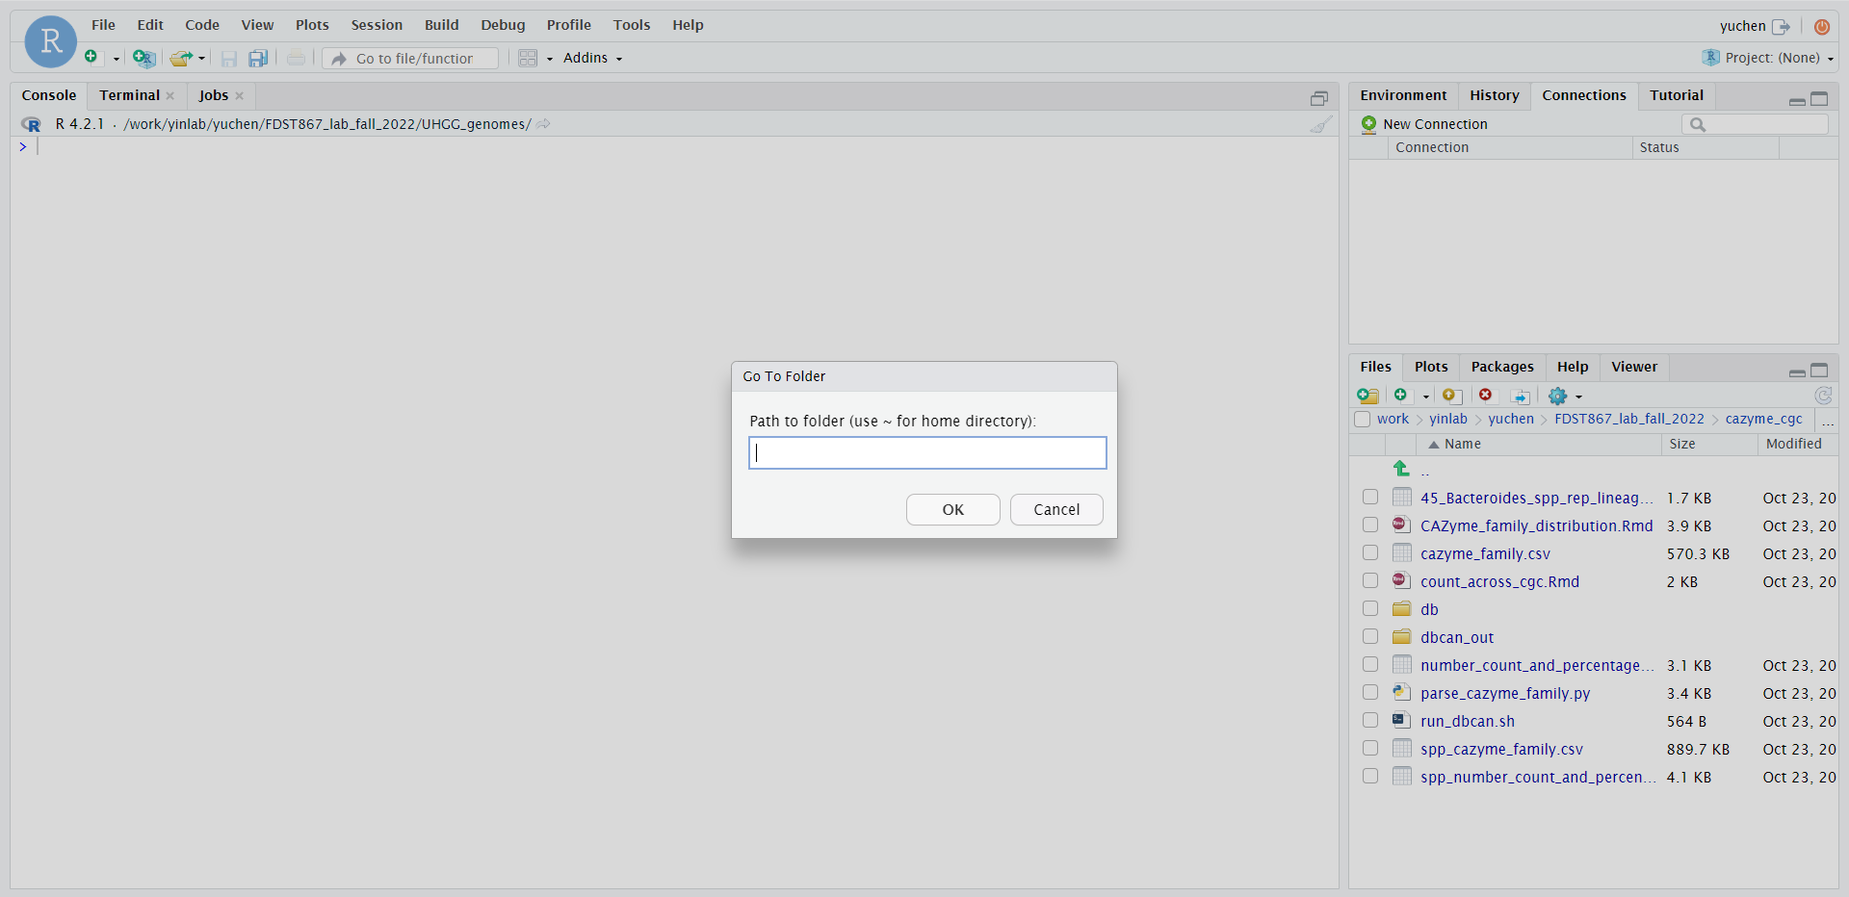
Visualization in RStudio
R Markdown file for making plots:
count_across_cgc.Rmd
CAZyme_family_distribution.Rmd
Set working directory to cazyme_cgc/
1.Click “…”to change directory
2. Enter your working directory path: /work/your_group/your_name/FDST867_lab_fall_2022/cazyme_cgc

Slide 34
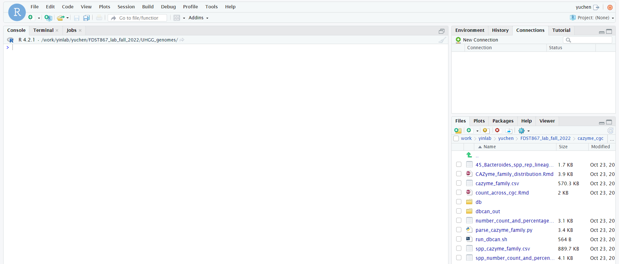
Visualization in RStudio
R Markdown file for making plots:
count_across_cgc.Rmd
CAZyme_family_distribution.Rmd
Set working directory to cazyme_cgc/
3. Open the two .Rmd files

Slide 35
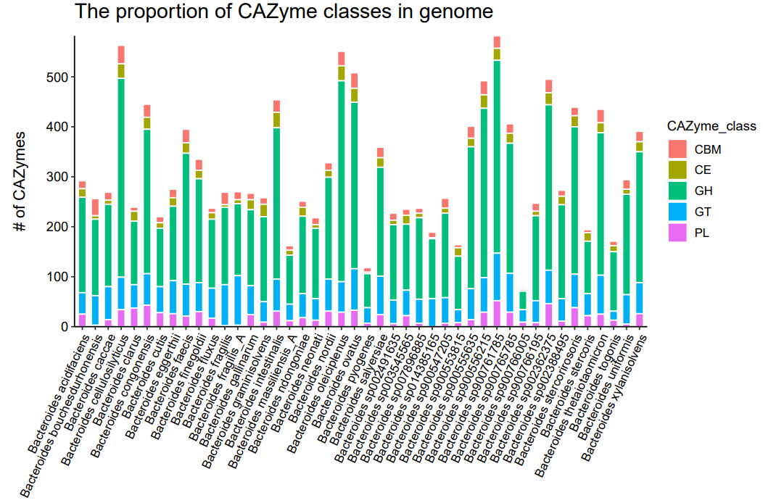
Plots of CAZyme and CGC analyses
The proportion of CAZyme classes in genome (cazy_class_stackbar.pdf)
The total number of CAZymes varies across genomes.
GH account for the largest proportion in most of genomes

Slide 36
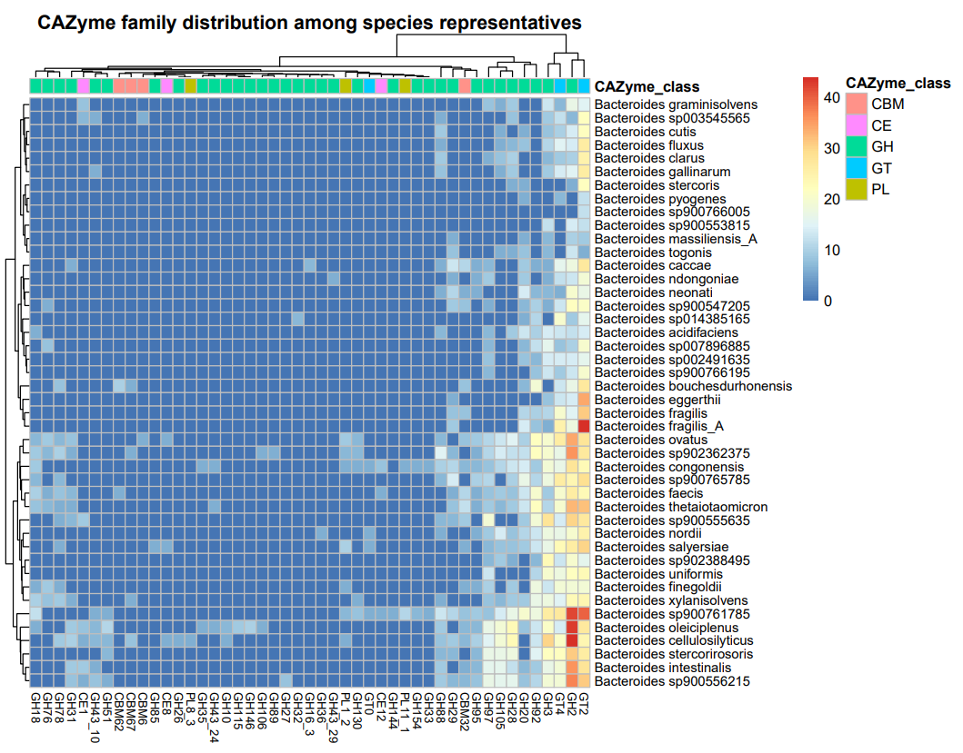
Plots of CAZyme and CGC analyses
CAZyme family distribution among spp representatives (cazy_distr_hm.pdf)
The number of CAZyme families in one genome > 5
Some CAZyme e.g. GT2, GH3 are very common and abundant

Slide 37
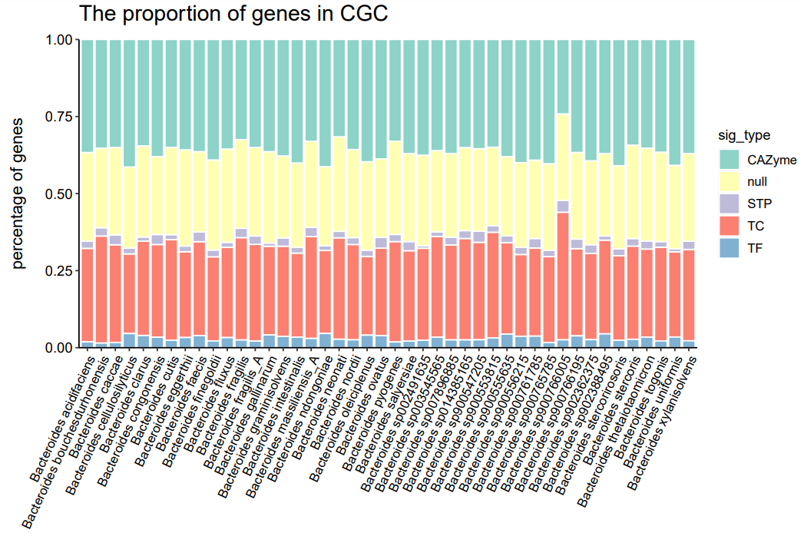
Plots of CAZyme and CGC analyses
The proportion of genes in CGC (prop_sig_cgc_stackbar.pdf)
Null genes account for a relatively large proportion within CGC in each genome

